Slide 1



IWQoS 2021
FedEraser: Enabling Efficient Client-Level Data
Removal from Federated Learning Models
Gaoyang Liu, Xiaoqiang Ma, Yang Yang, Chen Wang, Jiangchuan Liu

Slide 2




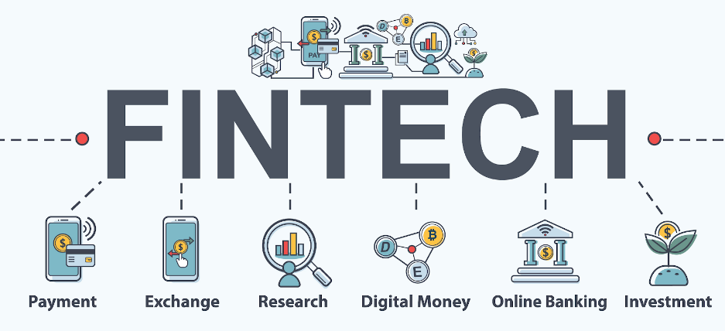
Background
Federated Learning (FL)

Slide 3
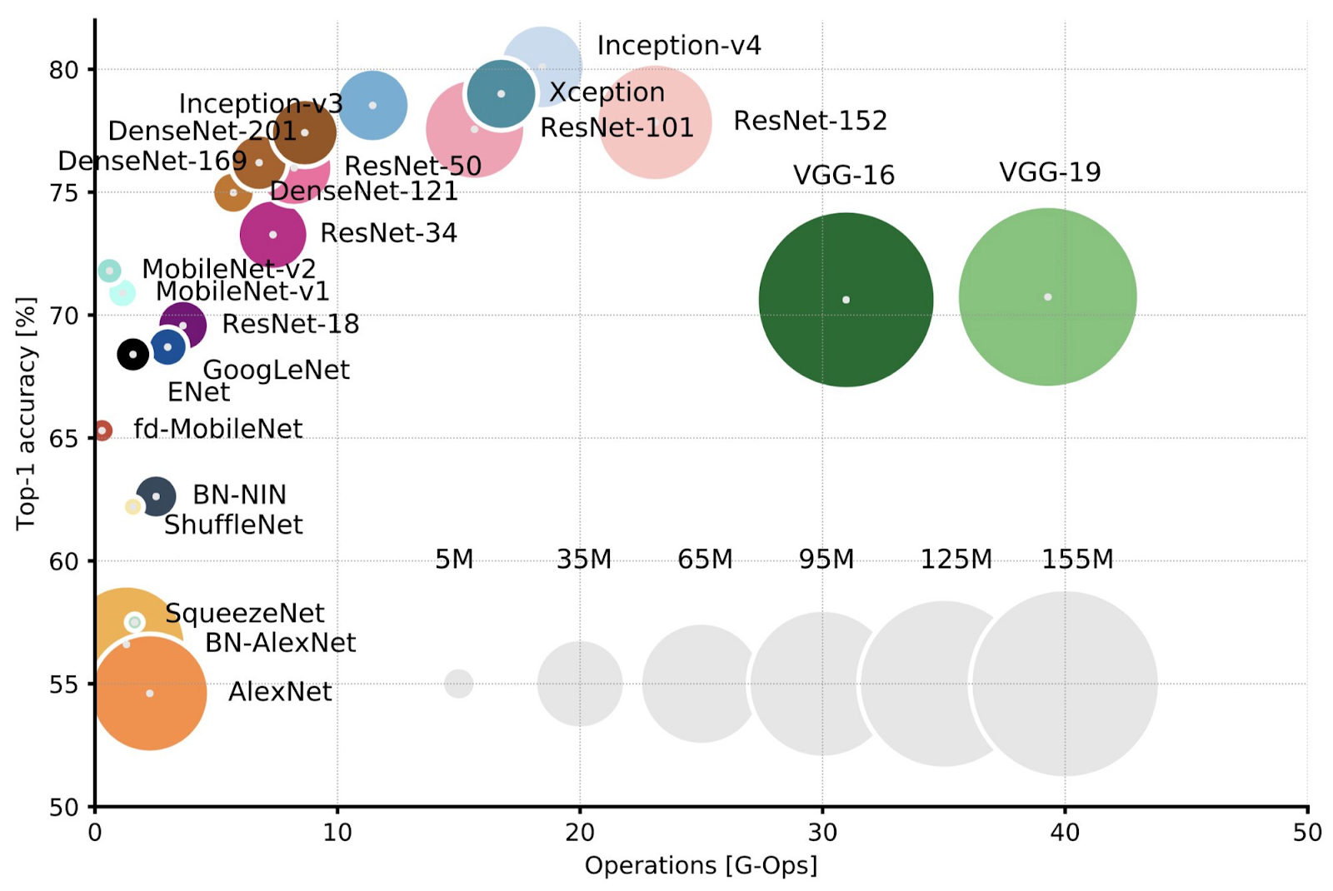
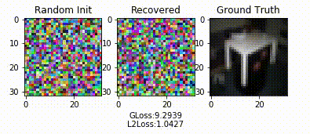
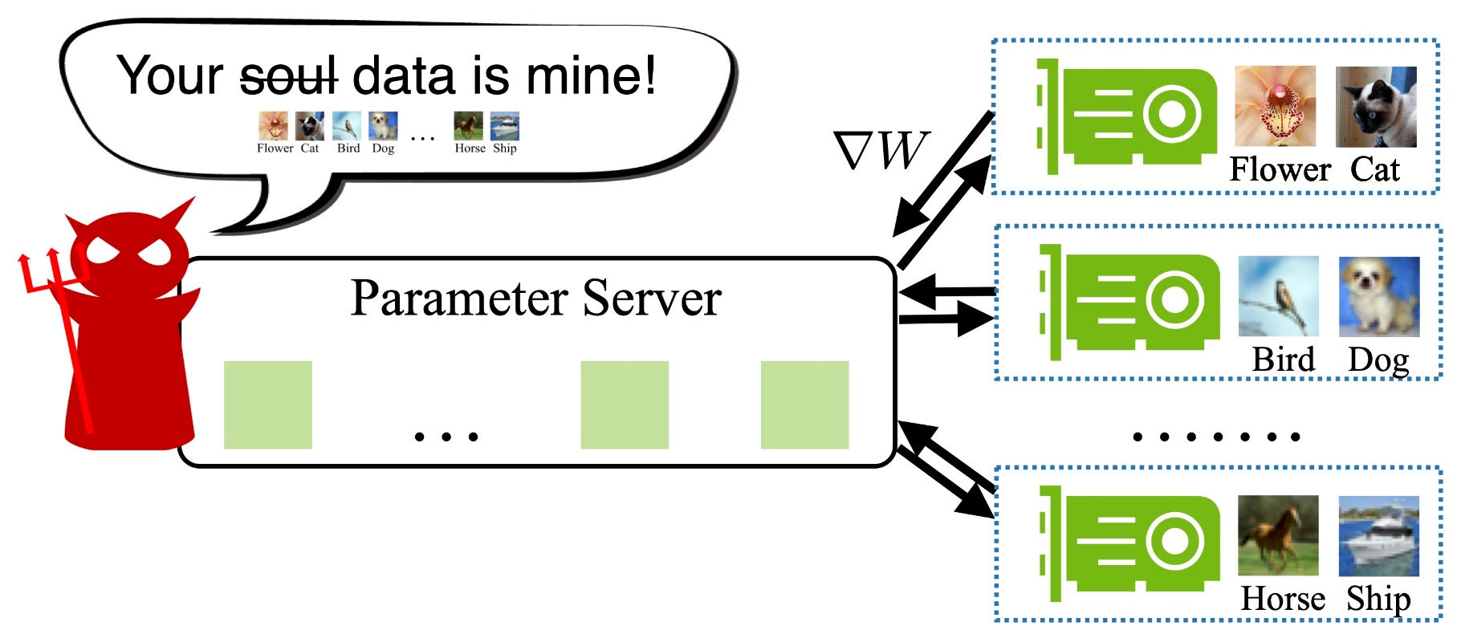
Background
Model size vs. Training data size
The parameters of model usually exceed the size of training data.
Overparameterized model causes unintended memorization.

Slide 4

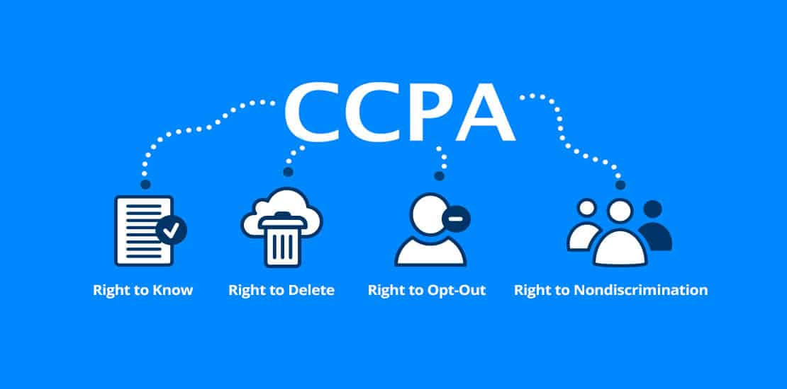


Background
New privacy legislation
Calls for transparency and clarity of data collection and usage
Allow users to remove their data

Slide 5
Motivation
Legitimation: Right-to-be-forgotten for data providers
Security: Eliminate poisoned training data and the corresponding influence on the federated model
Privacy: Remove the influence of the unlearned data from the trained model in FL
Concrete Problem:
How to unlearn data from trained FL models

Slide 6
What is Federated Unlearning?
Global Model 1
Learning
Unlearning
Relearning
Global Model 3
Global Model 2
Global Model 2 and Model 3 may be different

Slide 7
Existing Works
Naïve Solution (Baseline)
Remove data & retrain model from scratch
Intuitive, Simple to implement
Such an approach is very slow.
Other Solutions
Specialized for k-means clustering (Ginart et al.)
Projective residual update for linear regression (Izzo et al.)
Remove information from the output logits (Baumhauer et al.)
Sharding and slicing during the training (Bourtoule et al.)
Limited on centralized settings
Changes of the training process

Slide 8
Goals of FedEraser
Limited Overhead: FedEraser should not introduce additional overhead to what are already computationally-intense training procedures.
Reduced Unlearning Time: FedEraser should have lower time than the baseline for unlearning.
Comparable Accuracy: FedEraser should strive to introduce a small accuracy reduction compared with the baseline.
Applicable for FL: FedEraser should be suitable for distributed settings, such as Federated Learning.

Slide 9
Modification of FL Framework
Central Server

Slide 10
Design of FedEraser
FedAvg:

Slide 11
Design of FedEraser
FedAccum:

Slide 12
Design of FedEraser
Problem of FedAccum:
The retained updates of the remaining clients are not trained from the re-aggregated model.

Slide 13
Design of FedEraser
Calibration Training:
Update Calibrating:
Aggregating and Unlearning:

Slide 14
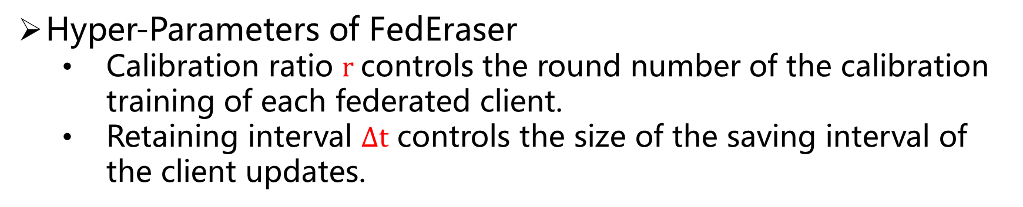
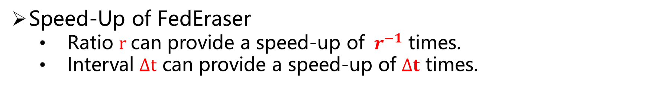
Time Consumption Analysis
Hyper-Parameters of FedEraser
Calibration ratio $r$controls the round number of the calibration training of each federated client.
Retaining interval $∆t$ controls the size of the saving interval of the client updates.
Speed-Up of FedEraser
Ratio $r$can provide a speed-up of $r^{−1}$ times.
Interval $∆t$ can provide a speed-up of $∆t$ times.
Overall, FedEraser can reduce the time consumption by
$r^{−1}∆t$ times compared with retraining from scratch.

Slide 15
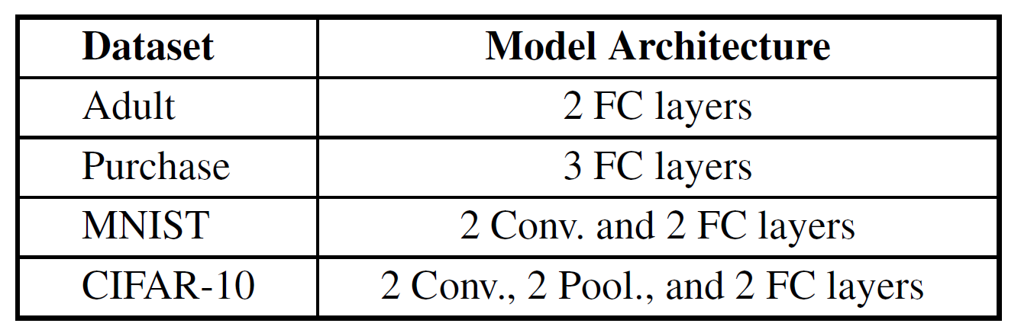
Experimental Setup
Dataset and Model Architecture
Comparison Methods
FedRetrain (Baseline): Retrain the global model from scratch on the remaining data after removing the target client’s data.
FedAccum (Without Calibration): Directly accumulate the previous retained updates, and leverage the accumulated results to update the global model.

Slide 16
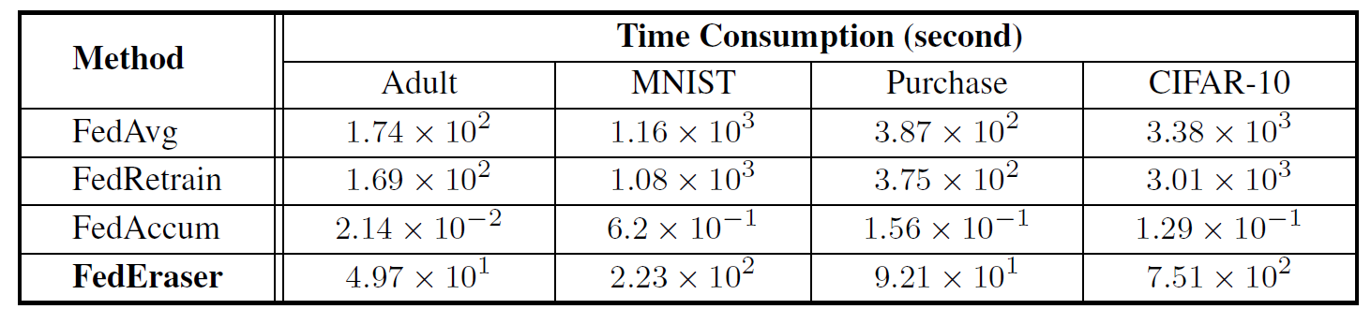
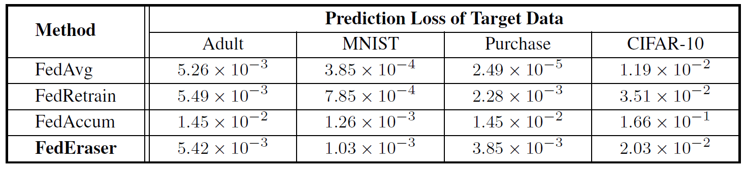
Performance Evaluation
We run faster and get comparable loss with retraining
Time consumption of federated model construction
Prediction loss on the target client’s data
4× Speed-Up

Slide 17
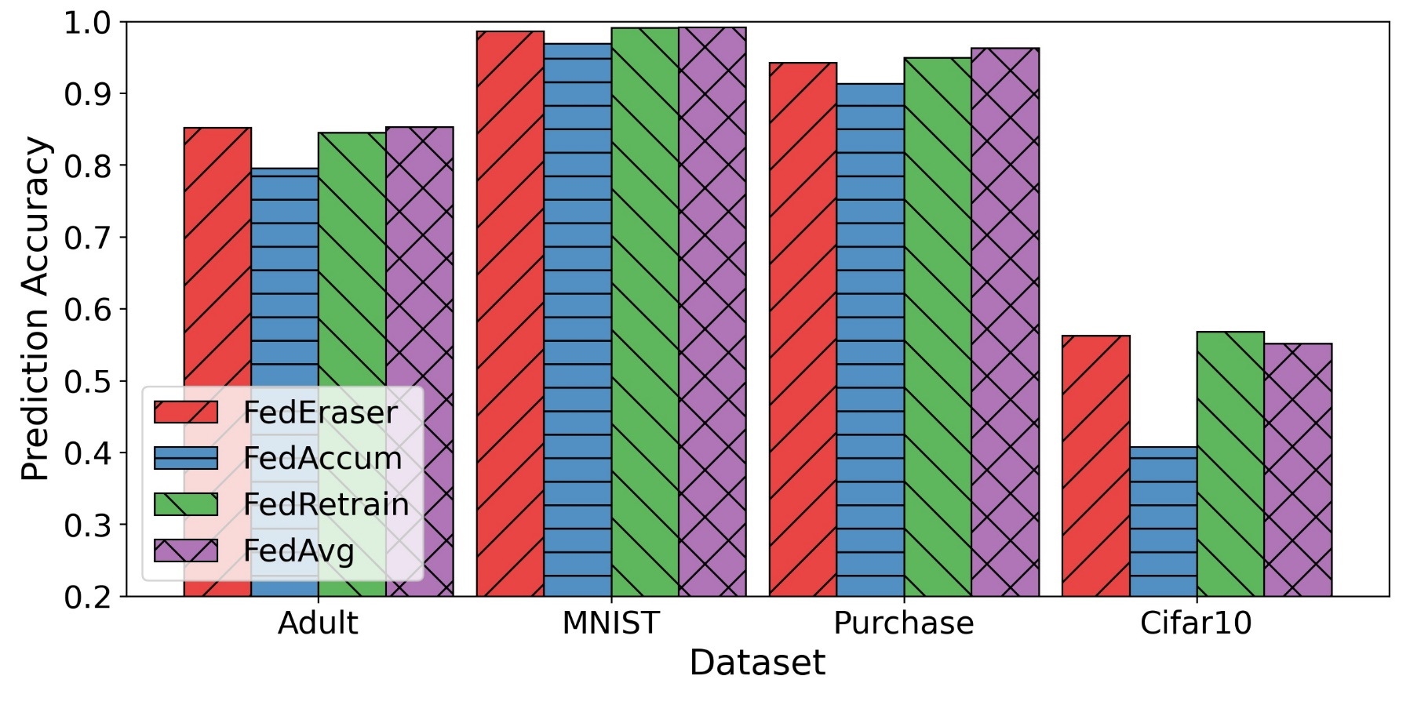
Performance Evaluation
We get comparable prediction accuracy with retraining
Prediction accuracy on the testing data
FedEraser performs closely as FedRetrain (baseline) on all datasets, with an average difference of only 0.61%.

Slide 18
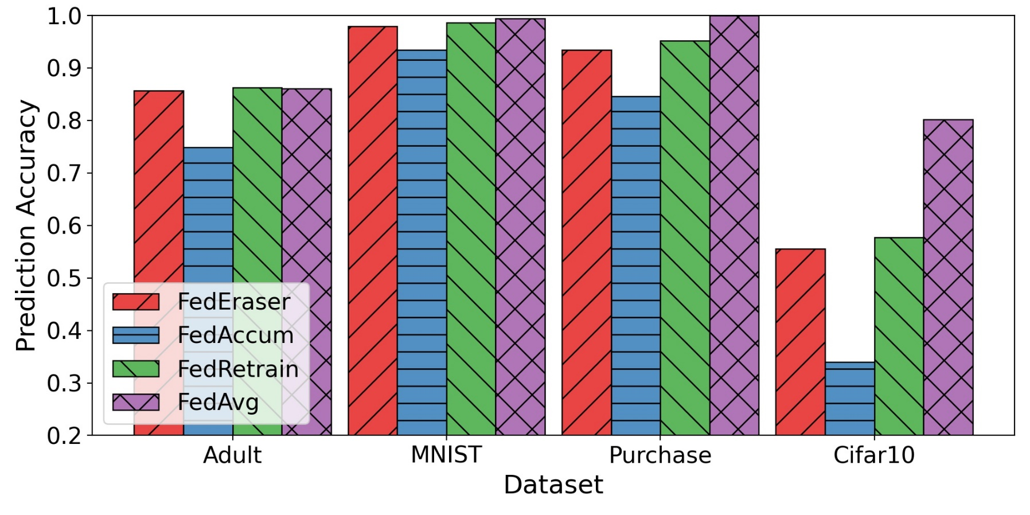
Performance Evaluation
We get comparable prediction accuracy with retraining
Prediction accuracy on the target data (i.e. unlearned data)
FedEraser performs closely as FedRetrain (baseline) on all datasets, with an average difference of only 1.27%.

Slide 19
Evaluation from Privacy Perspective
Membership inference attacks against target data
Goal: Determine whether a record in the target data was used to train the federated model.
Method:
Training Data
Original Model
Attack Model
Testing Data
Target Data
Unlearned Model

Slide 20
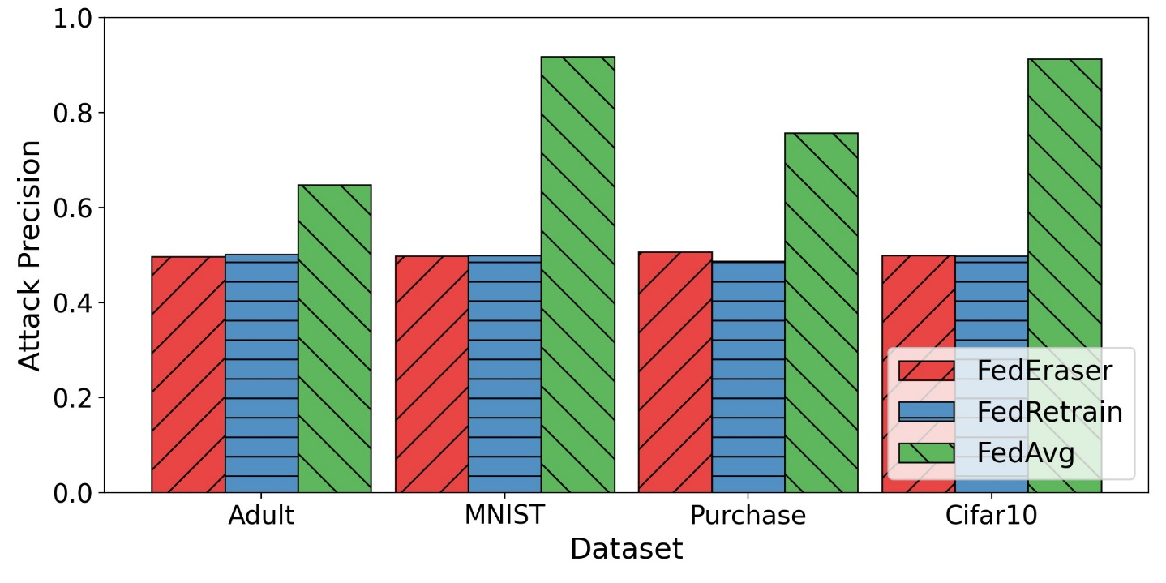
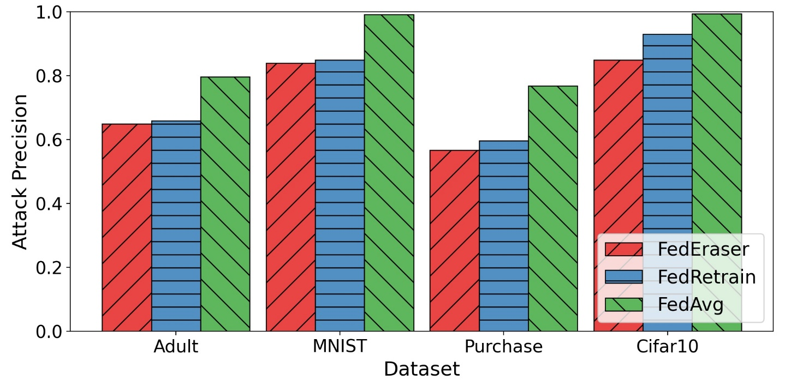
Evaluation from Privacy Perspective
Membership inference attacks against target data
Insight: The worse the performance of the attack is, the less influence of the target data is stored in the global model.
(a) Attack Precision
(b) Attack Recall
The attack can achieve a mean precision (resp. recall) around 0.50 (resp. 0.726) on the unlearned mode, which are close to random guess.

Slide 21
Summary
FedEraser
Frame the problem of federated unlearning, and present the first efficient unlearning algorithm in FL.
Non-intrusive and can serve as an opt-in component inside existing FL systems.
Require no information about the target client, enabling the unlearning process performed unwittingly.
Future Work
Dynamically adjust the parameters of FedEraser, including retaining interval and calibration ratio.
Implement FedEraser at the data sample level.

Slide 22
Thanks for your attention

